Slide 1
Google Smart Lock Introduction into Google Smart Lock
Bill Zangardi | February 22, 2017

Slide 2
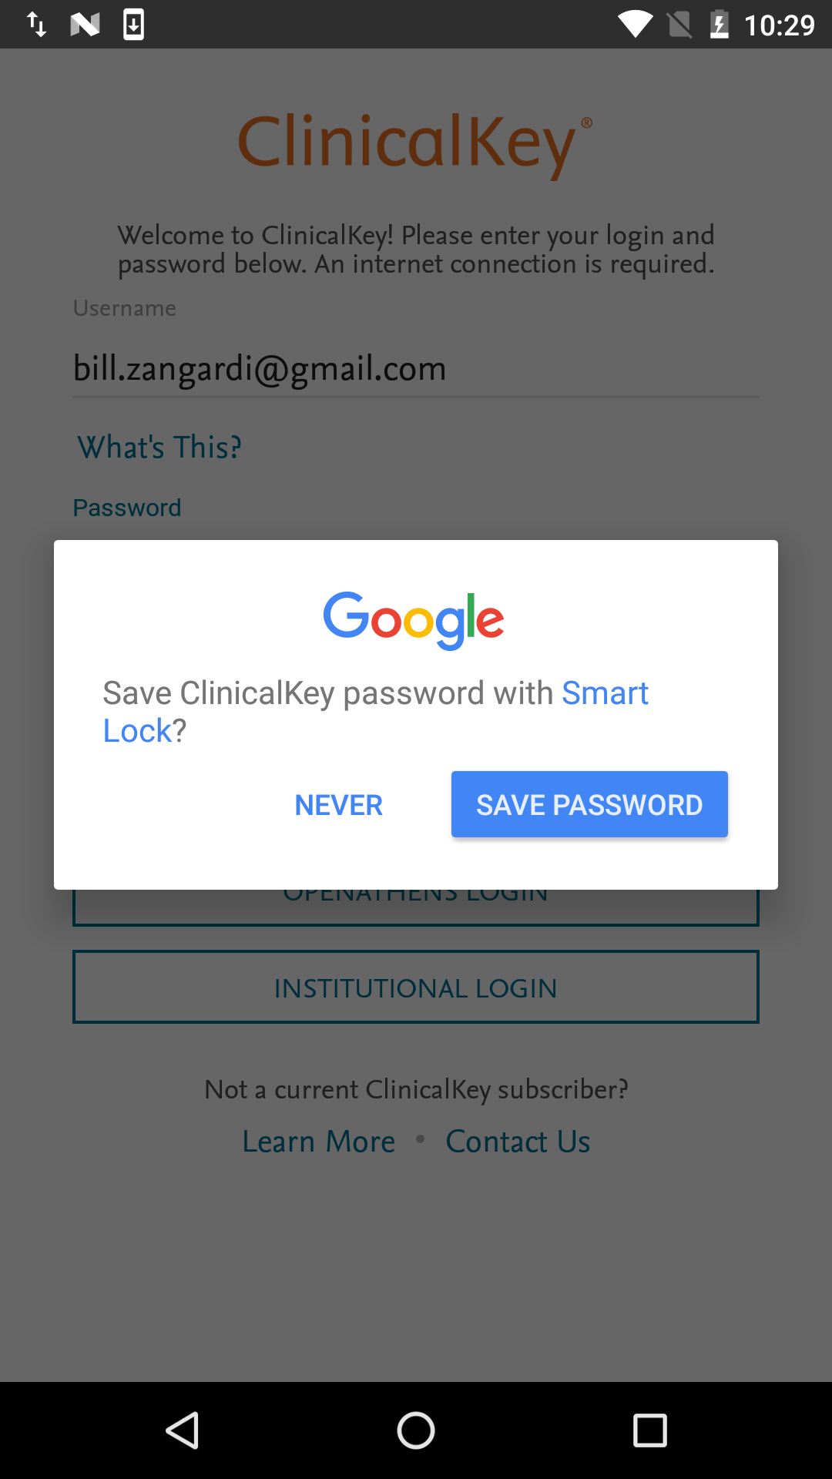
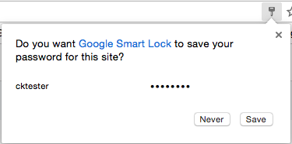
What is Google Smart Lock?
• Cloud keychain to keep all your website and app credentials in
one secure place
• Available for Android, Chrome, and Chromebooks
• Allows for cross-platform shared credentials
(Website -> App, App -> Website, etc.)
• Allows easy login options for common websites like
Google, Facebook, etc.

Slide 3
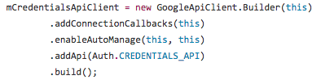
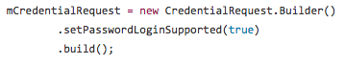
Getting Started
Add Google Play Services for auth (`com.google.android.gms:play-services-auth:9.X.X`)
Create an instance of the Google API Client with the Auth API

Slide 4
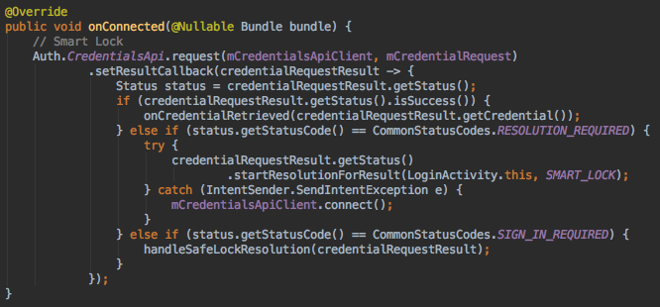
Google API Client onConnected() callback

Slide 5
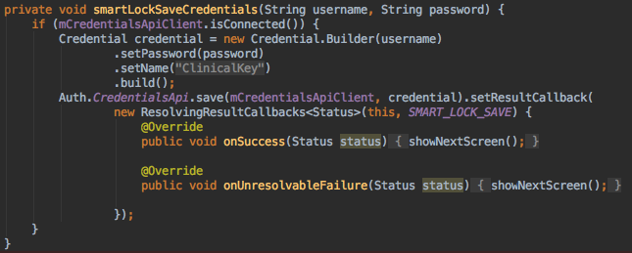
Saving Credentials to Smart Lock

Slide 6
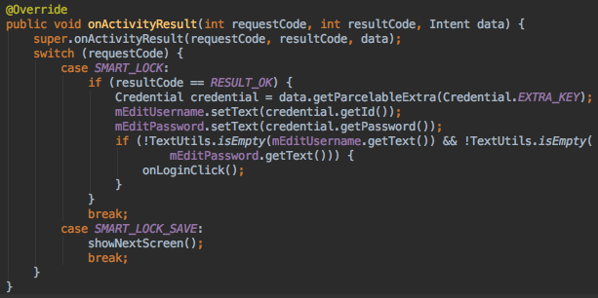
Handling Results from Smart Lock

Slide 7
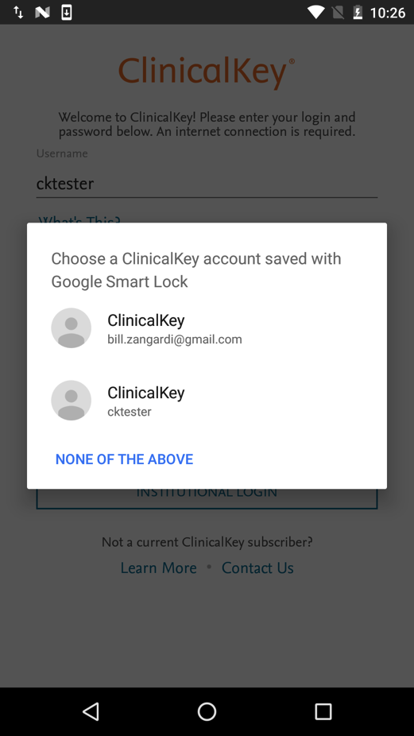
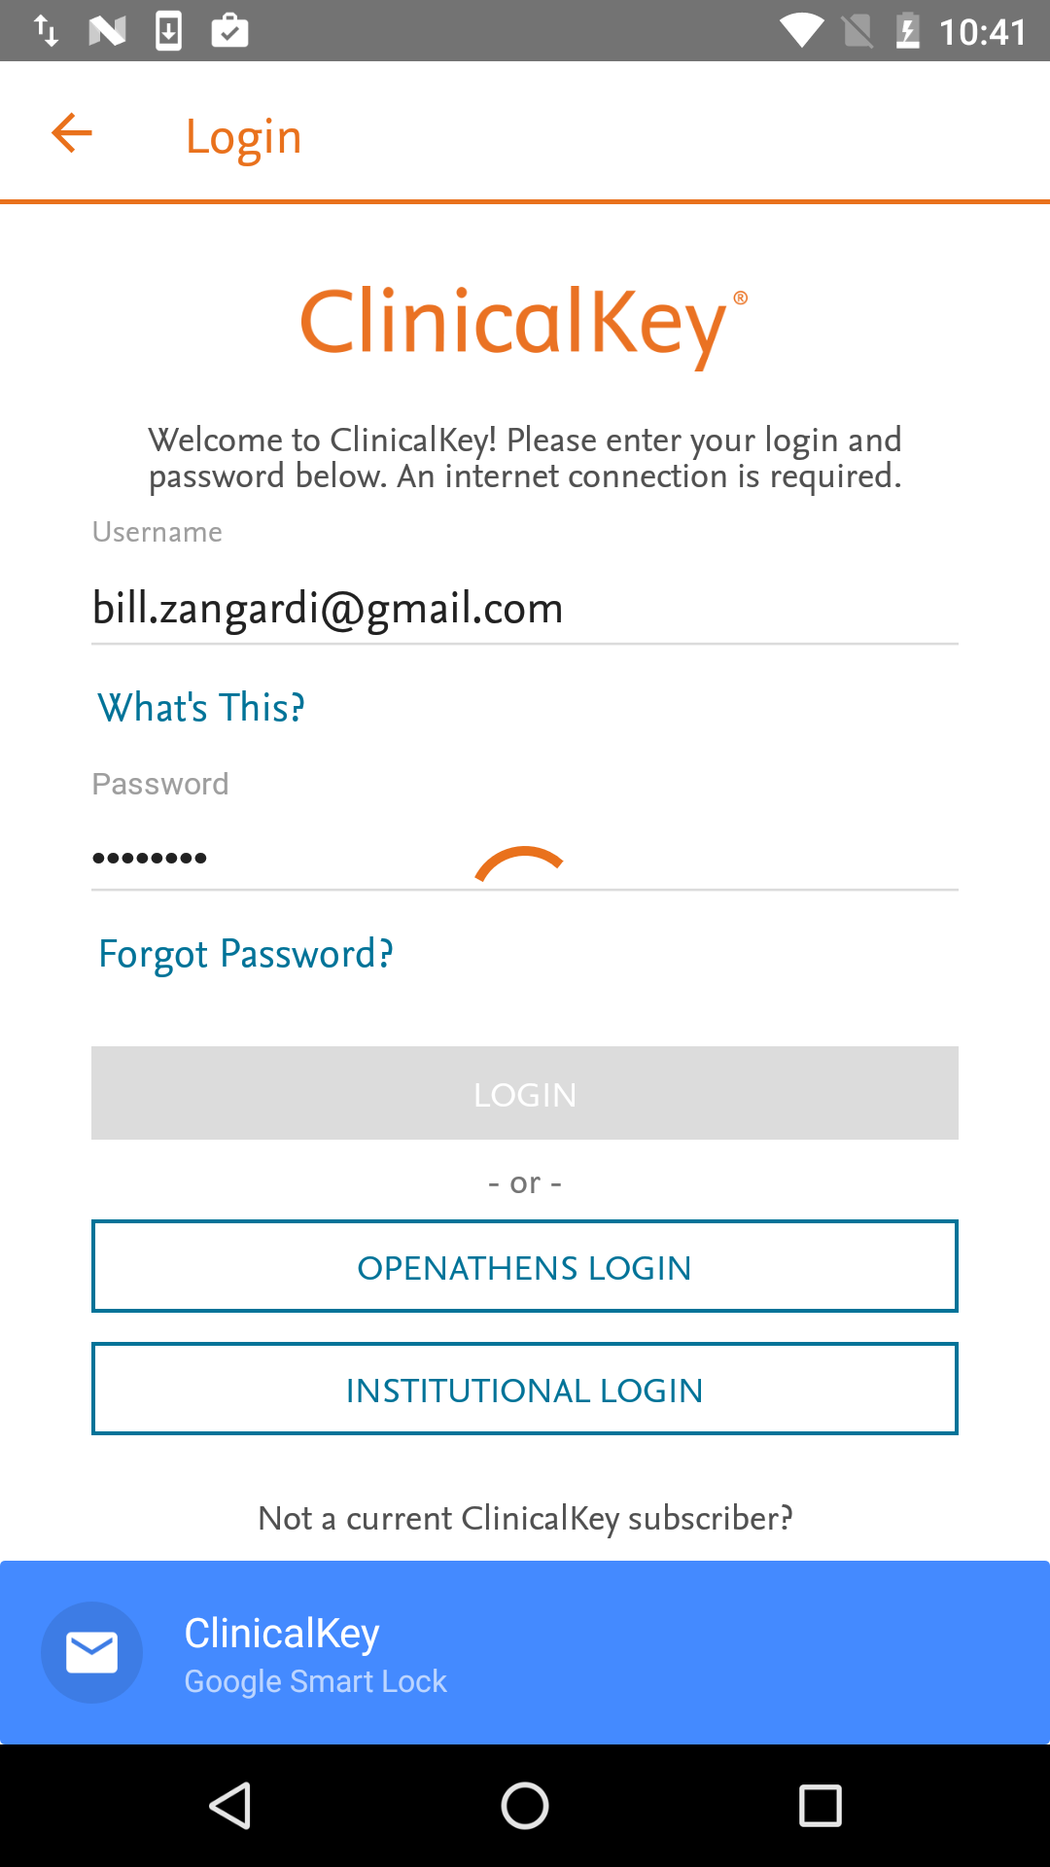
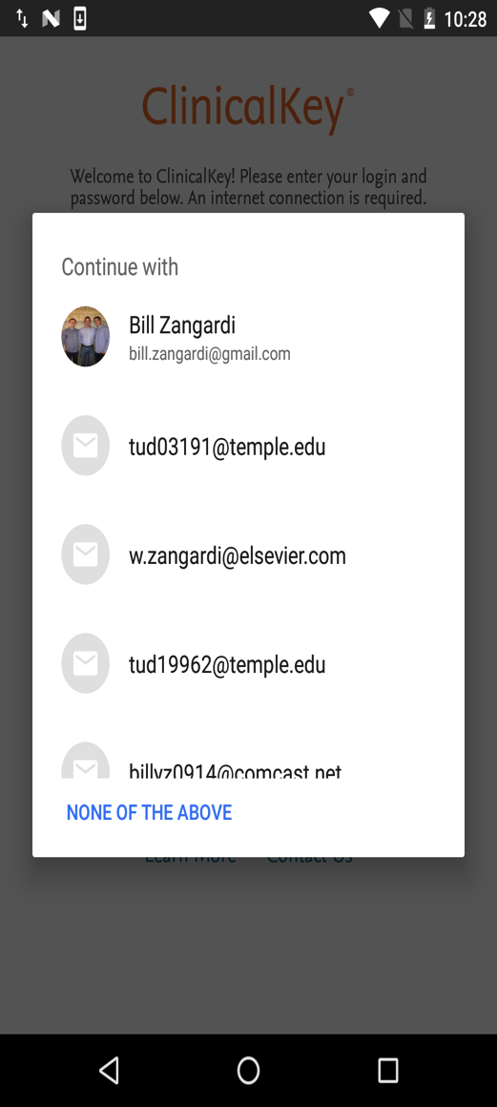
Different Smart Lock States

Slide 8
Cross-Platform Use
Allows a users website credentials to be used within your app and vice-versa
Requires registration of your app
https://docs.google.com/forms/d/1UFsC7aMT5IT02PH9Hpbq0vvGJycShlUAKVp8s0QGb9w/viewform
Requires website to host an assetlinks.json file, same file used to incorporate deep-linking:
https://www.clinicalkey.com/.well-known/assetlinks.json

Slide 9

Demo

Slide 10
Questions?
Additional Sources
• https://developers.google.com/identity/smartlock-passwords/android/overview
• https://passwords.google.com
• Droidcon NYC 2016 https://www.youtube.com/watch?v=OYQsNZLSphU
• Google I/O 2016 https://www.youtube.com/watch?v=0ucjYG_JrEE&t=11m08s

